Slide 1
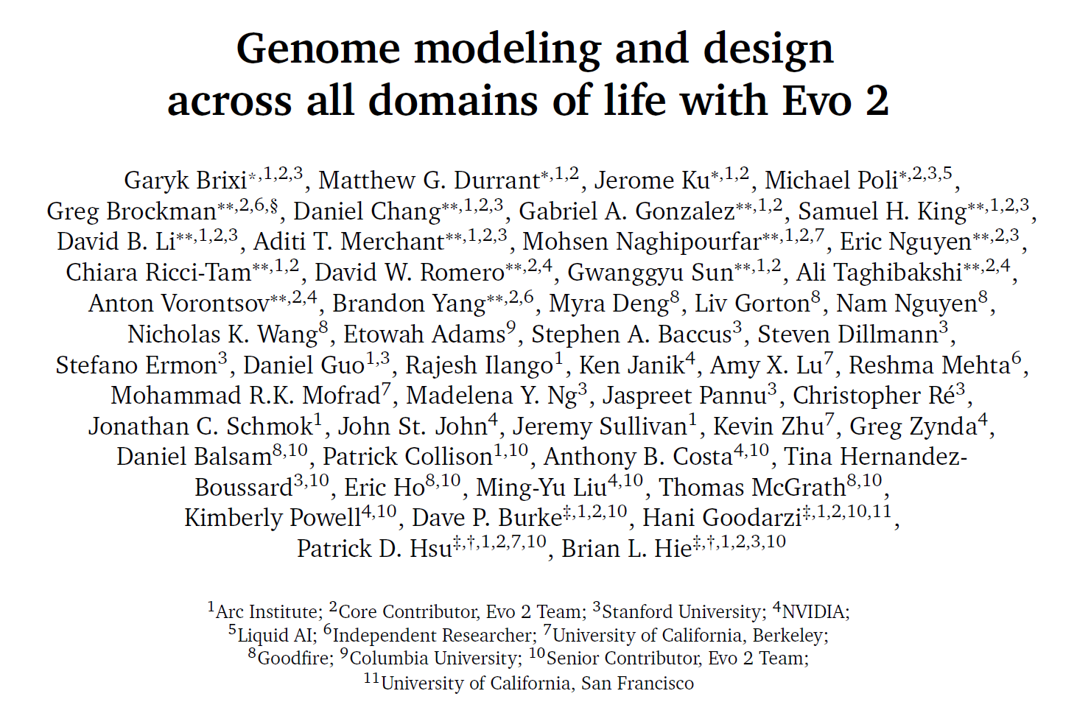
JC 2.28

Slide 2
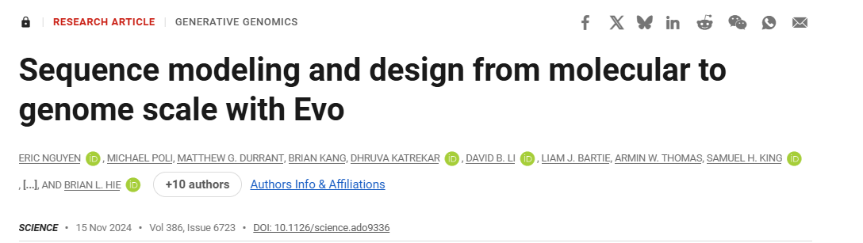
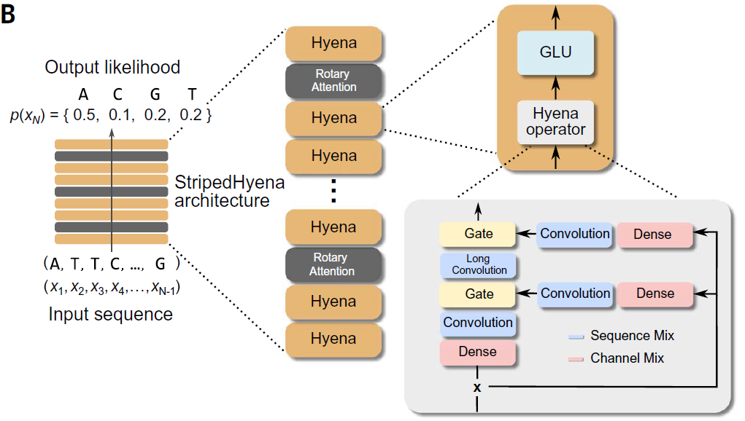
Background: Evo 1
DNA language model trained on 2.7 million prokaryotic and phage genomes
Comprehensive understanding of DNA from single nucleotide to entire genome
Multimodal generation tasks, demonstrated by generating synthetic CRISPR-Cas molecular complexes and transposable systems
StripedHyena architecture
Autoregressive modeling

Slide 3
Evo 2 model architecture, training procedure, and data

Slide 4
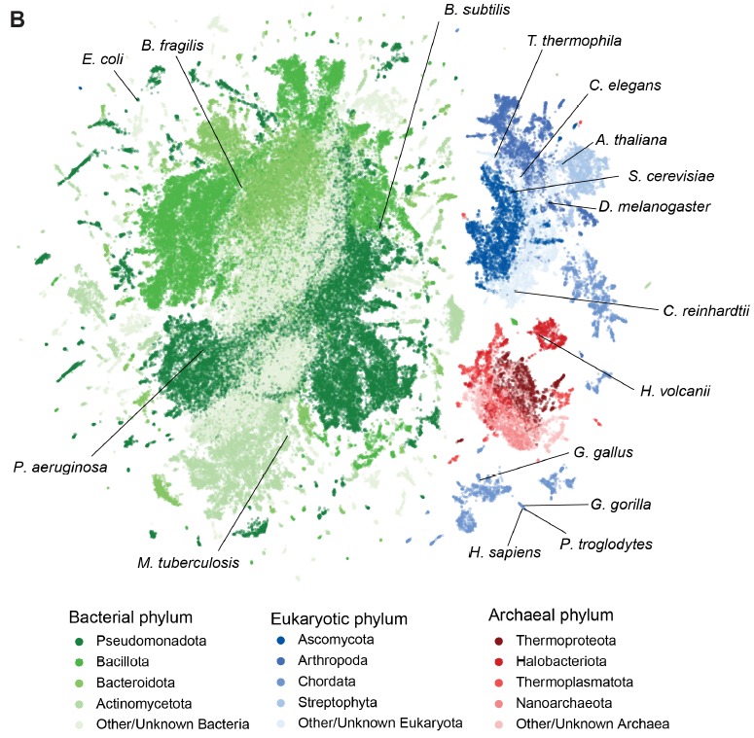
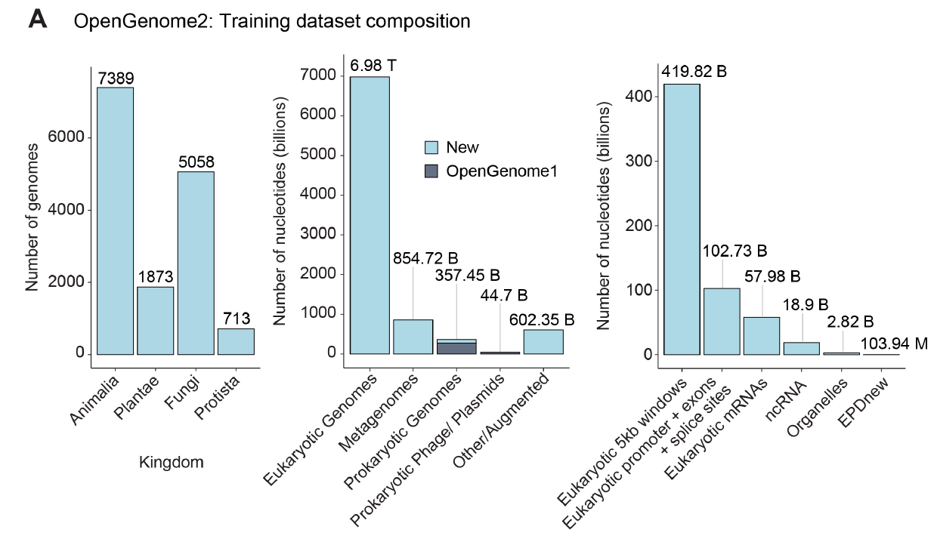
Training data
OpenGenome2, 8.8 trillion nt
Each nt is a token

Slide 5
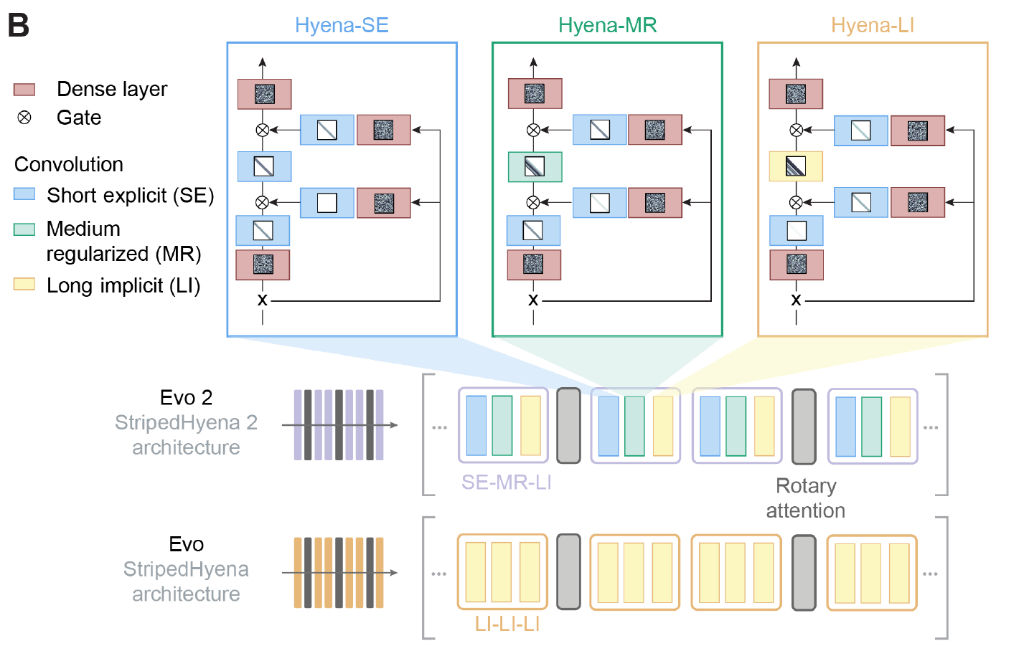
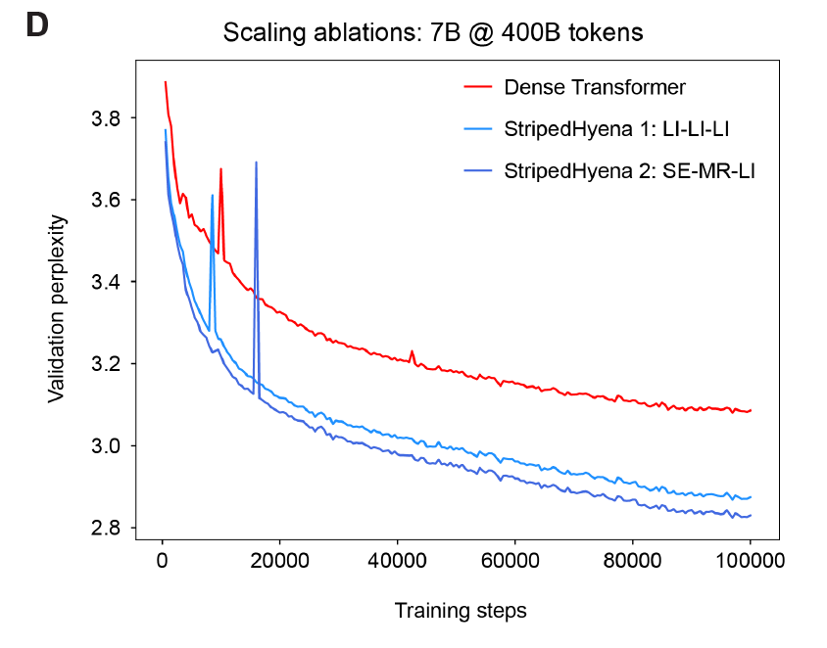
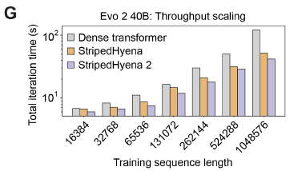
Model architecture: StripedHyena 2
StripedHyena 2 provides substantially higher throughput (at 40 billion parameters, up to 1.3× speedup at 16 thousand context length and 3× speedup at 1 million context length) than highly optimized Transformer
Faster loss convergence
Shorter training time

Slide 6
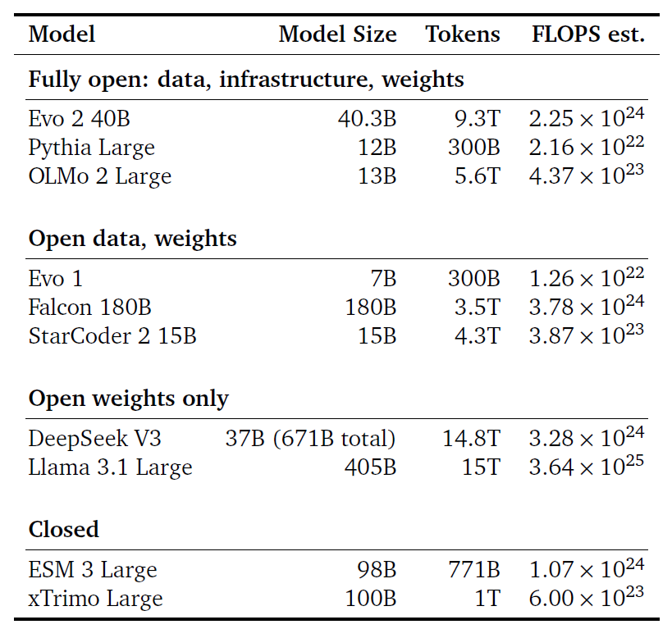
Comparison with other LLMs
BioLLM

Slide 7
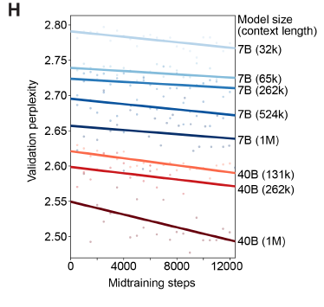
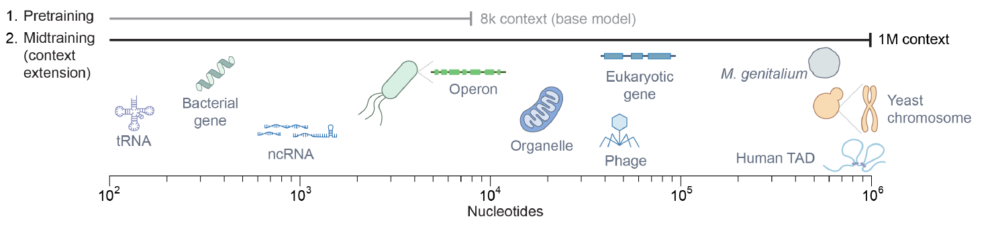
Training procedures
Multi-step multi-scale training
Short functional elements -> long range patterns
Larger model and longer context improve performance
Parameter: 40B > 7B
Context: 1M > 262k > 131k > …

Slide 8
Evo 2 predicts mutational effects on protein, RNA, and organismal fitness across all domains of life

Slide 9
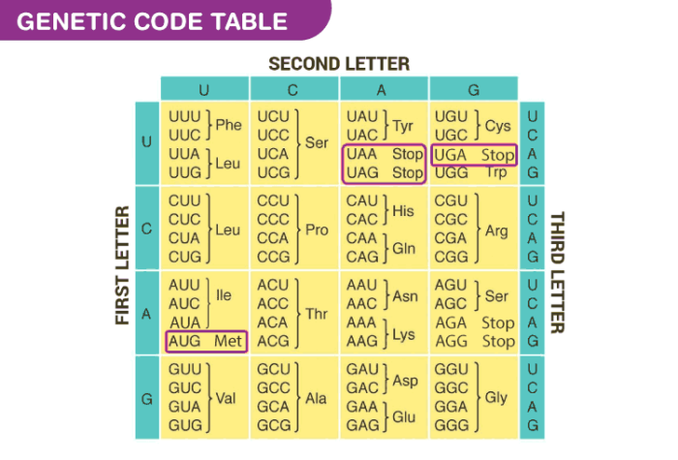
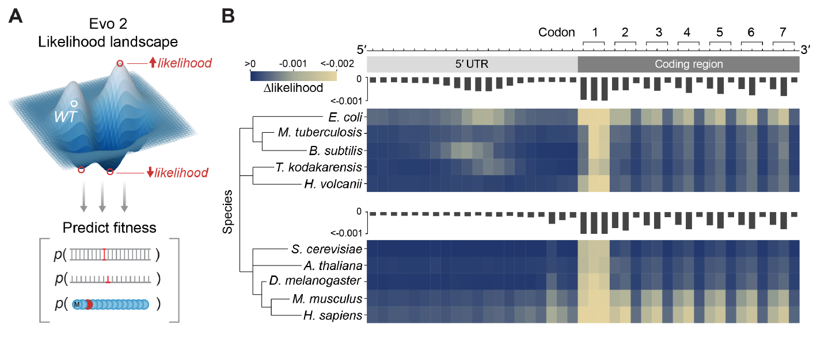
Mutation effect prediction: codon
Δlikelihood indicates change in fitness
Mutation in first 2 nt in codons decrease fitness (recall codon degeneracy), and ribosome binding region

Slide 10
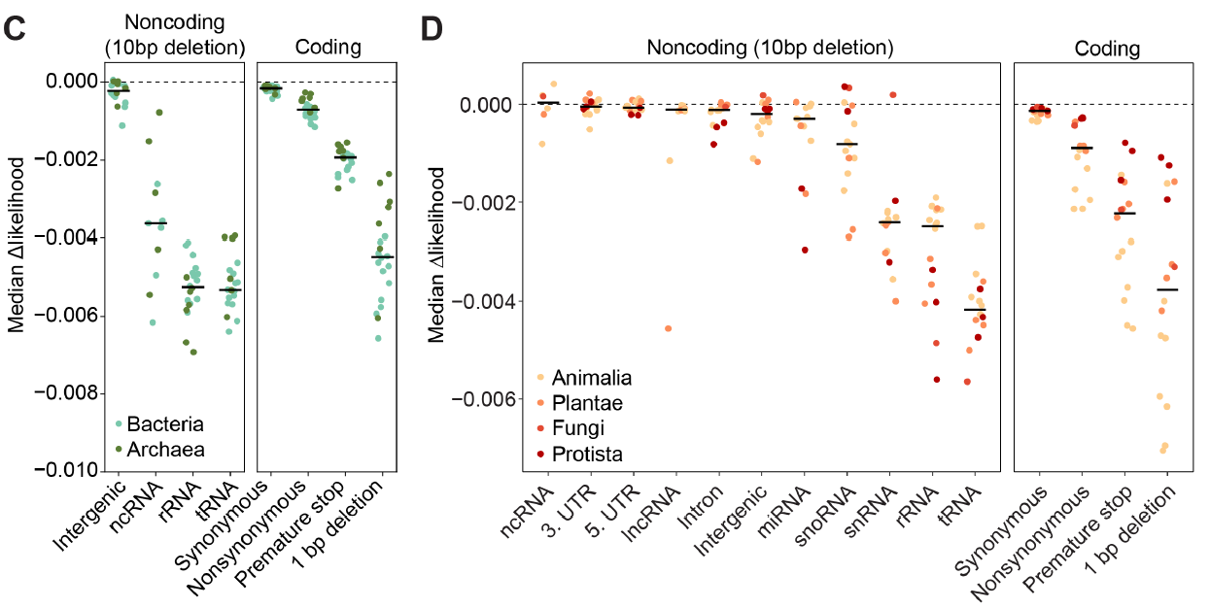
Mutation effect prediction: genomic regions
Mutations in important genomic regions decrease fitness

Slide 11
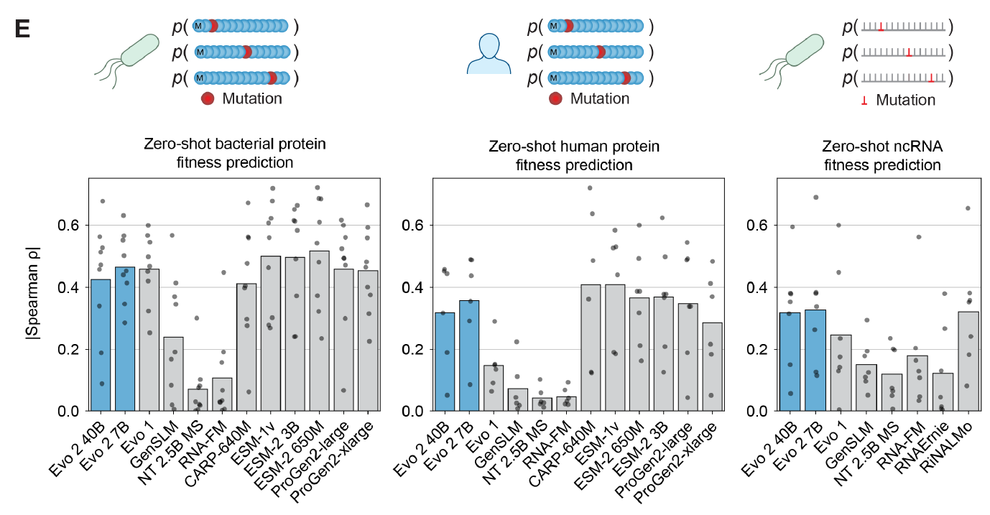
Mutation effect prediction: validation using deep mutational scanning
Higher values indicate higher correlation with experimental results
Evo2 is best at ncRNA fitness prediction

Slide 12
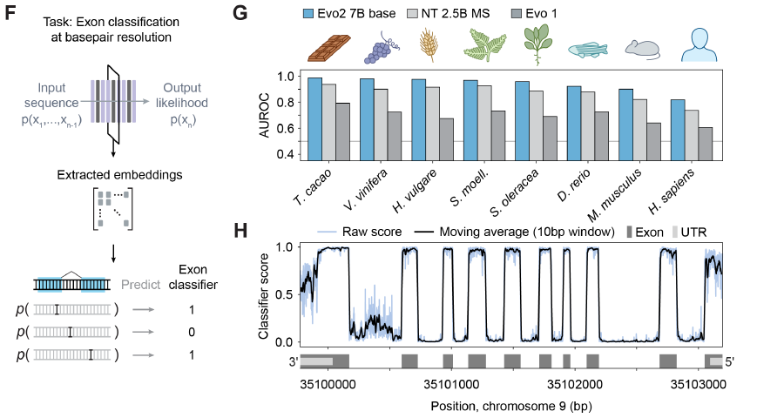
Using Evo2 to predict exon regions
Evo 2 embeddings were used to train an exon classifier, achieving high accuracy across eight diverse species

Slide 13
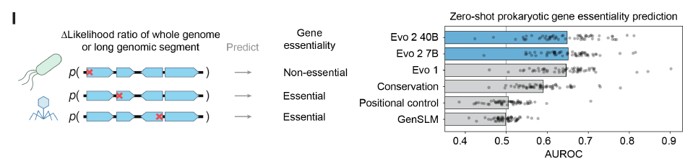
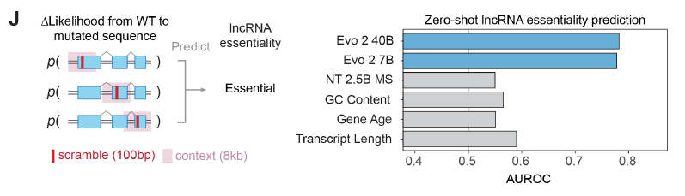
Using Evo2 to predict gene essentiality
Inserting stop codon in prokaryotic genes
Scrambling 100 bp in lncRNA

Slide 14
Evo 2 enables accurate human clinical variant effect prediction

Slide 15
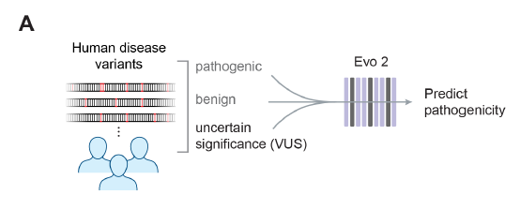
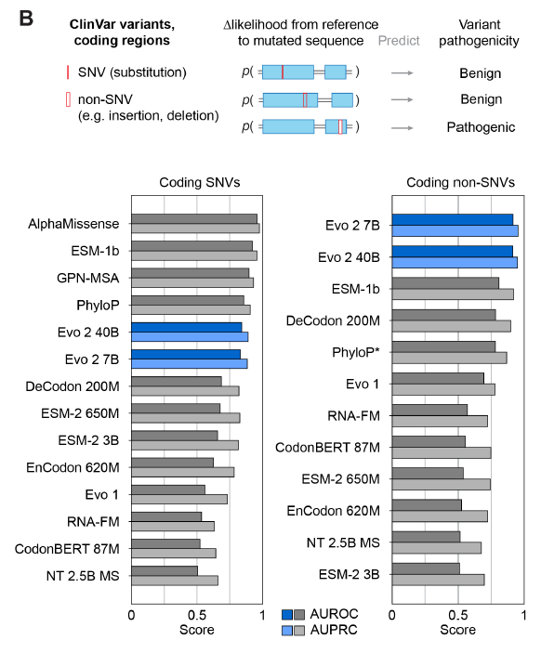
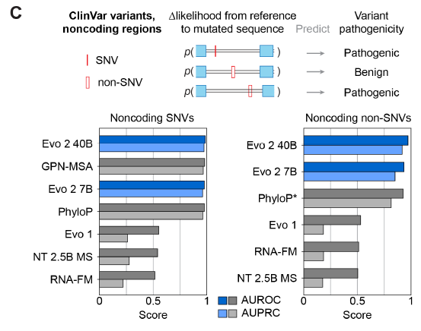
Mutation effect prediction: clinical variant pathogenicity
Evo 2 ranked among the top models for coding SNVs and outperformed others for noncoding and non-SNV variants

Slide 16
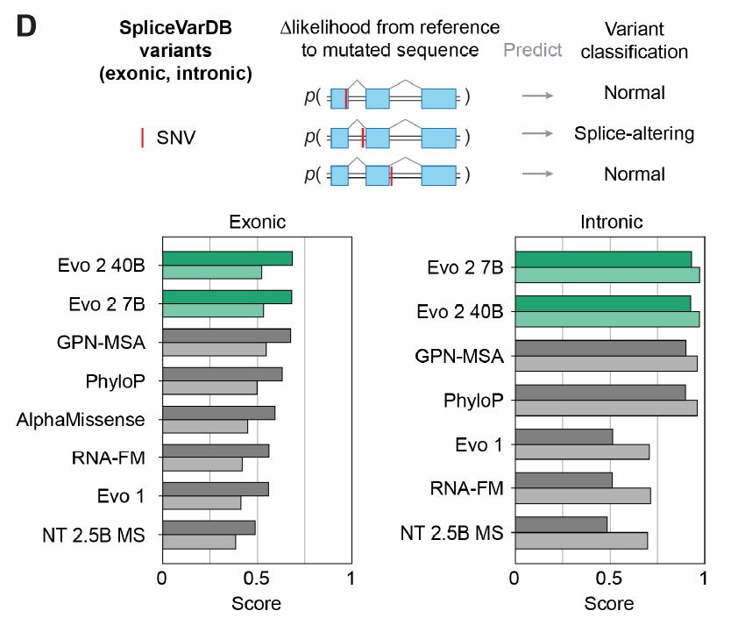
Mutation effect prediction: variant for splicing
Evo 2 has highest zero-shot performance for both exonic and intronic splice sites

Slide 17
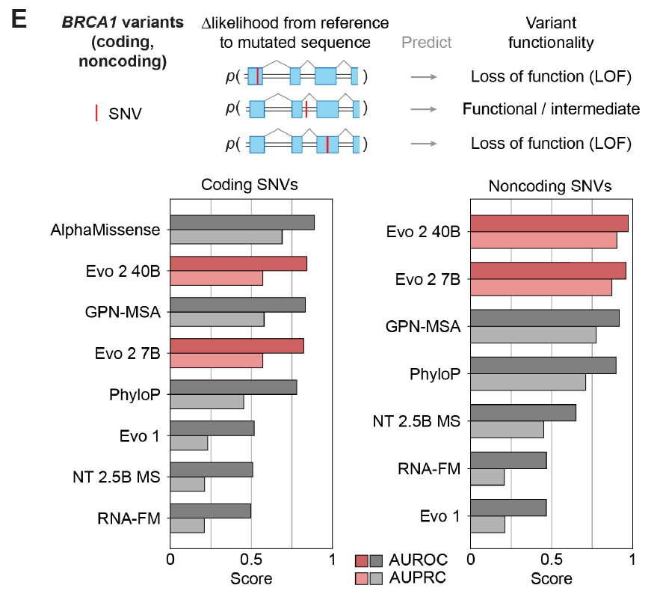
Mutation effect prediction: BRCA1 variants
Evo 2 ranked among the top models for coding SNVs and outperformed others for noncoding and non-SNV variants

Slide 18
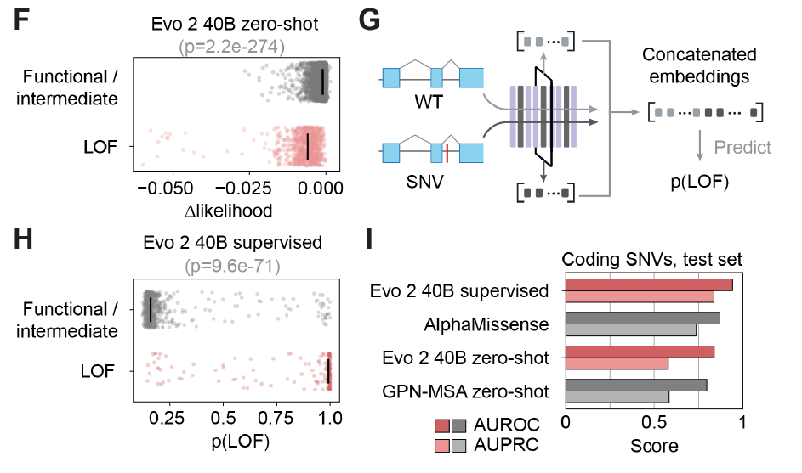
Mutation effect prediction: BRCA1 variants
Train a supervised classifier to predict LOF variants
Outperforming other models

Slide 19
Feature interpretation in Evo 2 from molecular to genome scale
Aim: extract and explain model-derived features from Evo2 model

Slide 20
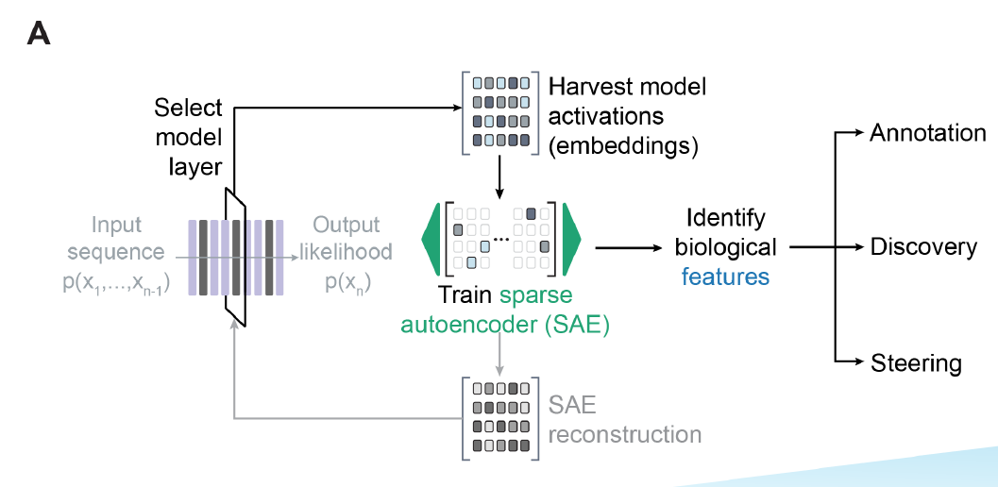
Extracting semantically meaningful genomic features from Evo2
Train Batch-TopK sparse autoencoders (SAEs) on layer 26 outputs to extract features

Slide 21
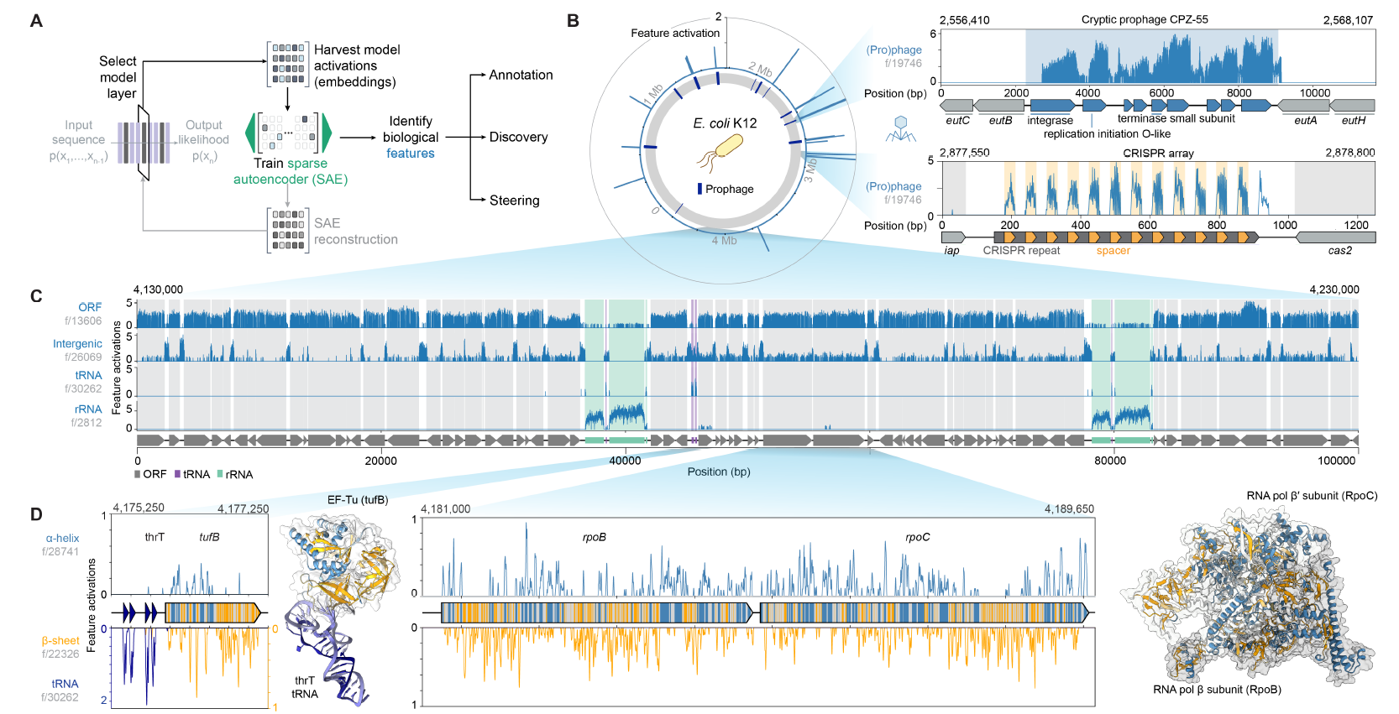
Examples of extracted features in E. coli
Feature: prophage (mobile element)
Feature: ORF/intergenic/tRNA/rRNA
Feature: α-helix/β-sheet/tRNA (protein structure)

Slide 22
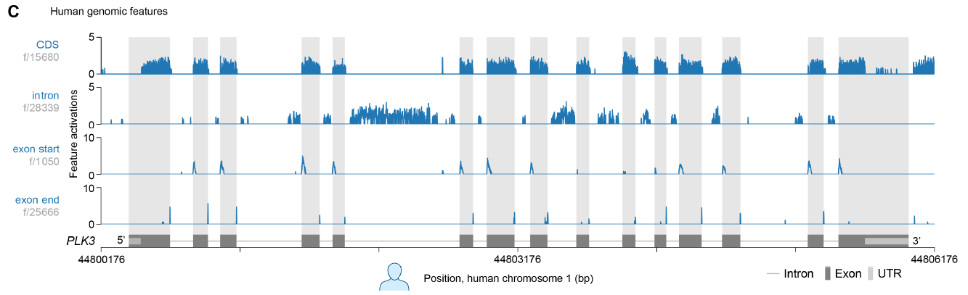
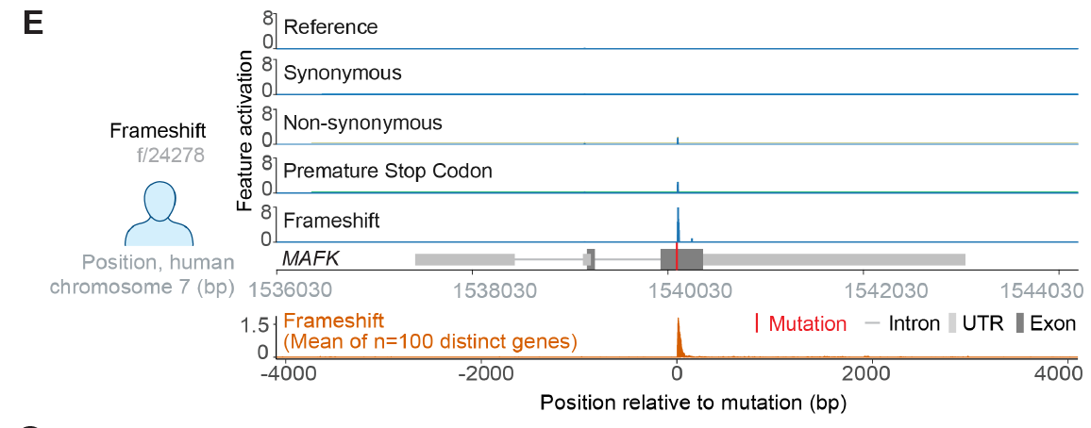
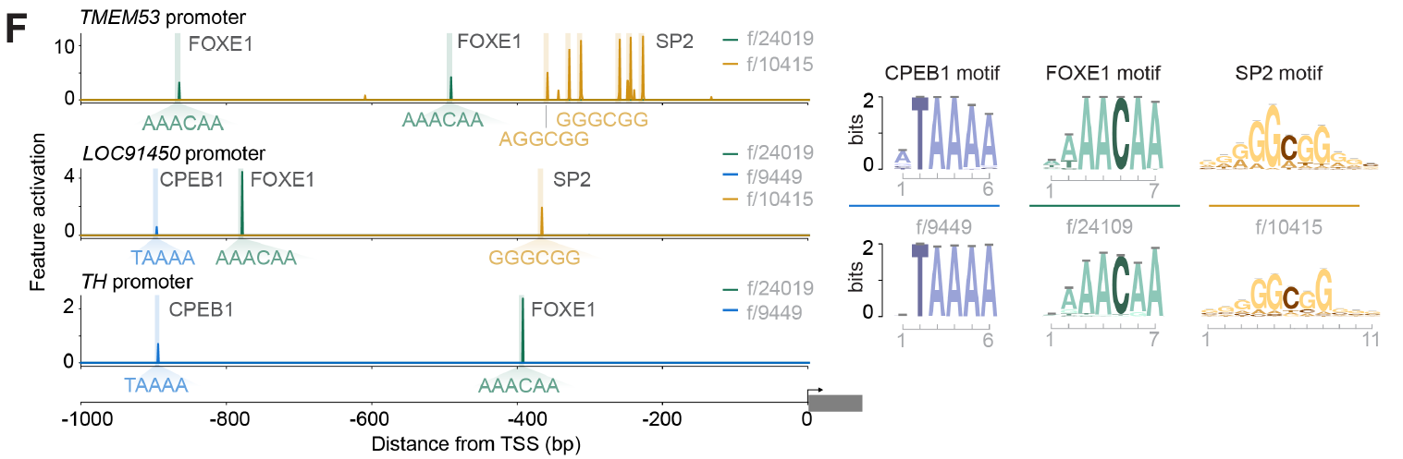
Examples of extracted features in human
Feature:
Exon
Intron
Exon start
Exon end
Feature: frameshift
The motif of some features are similar to TF motifs
Feature: promoter

Slide 23
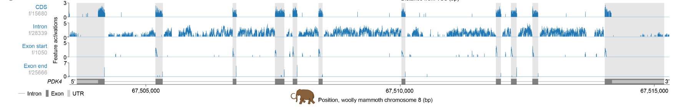
Evo 2’s features captured conserved biological signals across species
The extracted exon and intron features generalized to annotate the woolly mammoth genome, which was not in the training set
Feature:
Exon
Intron
Exon start
Exon end

Slide 24
Genome-scale generation across the domains of life
Aim: unconstrained autoregressive generation to generate natural-like DNA sequence

Slide 25
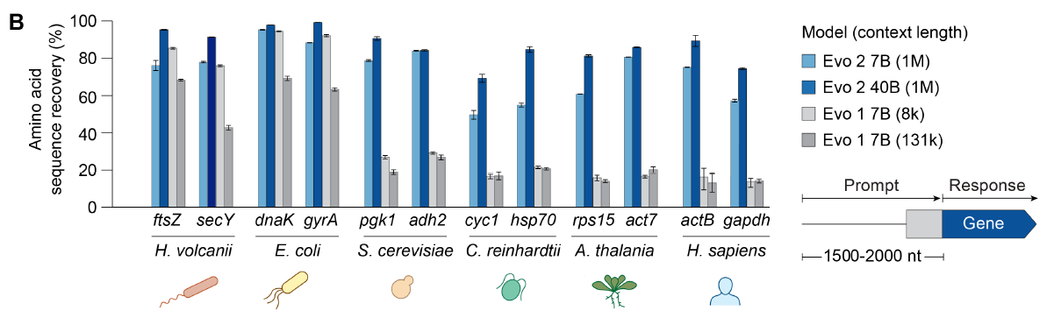
Genome generation: conserved gene completion
Select representative conserved genes from different organisms
Prompt: 1000 nt upstream + 500~1000 nt gene starts
Amino acid sequence recovery:
Generated DNA -> amino acid sequence -> aligned to reference protein

Slide 26
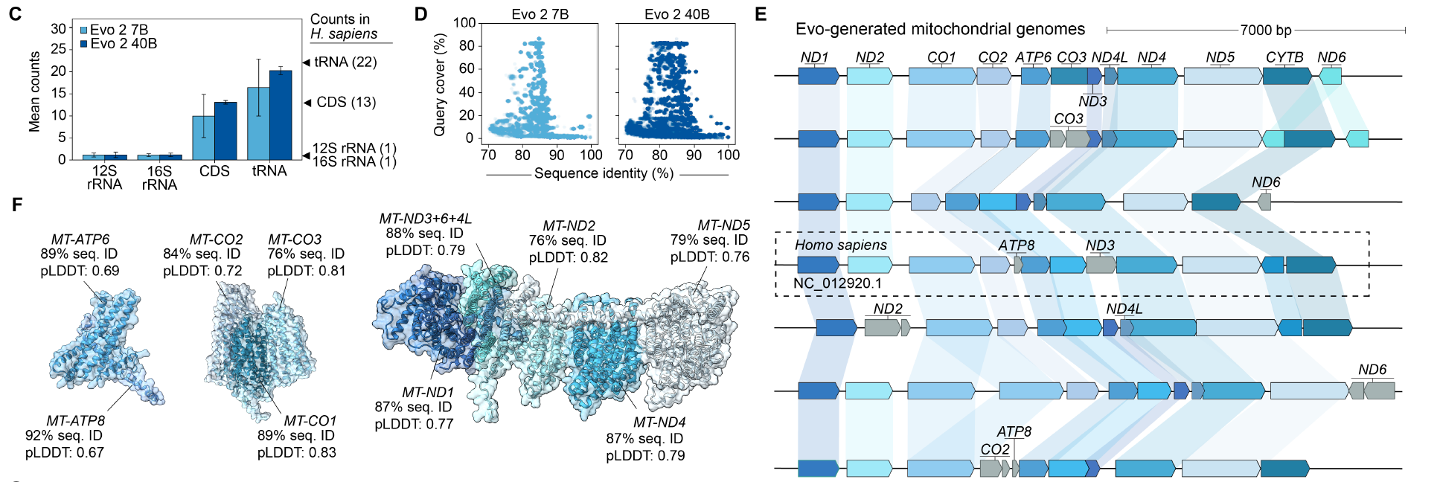
Genome generation: mitochondrial genome
Generated 250 human mitochondrial genomes, accurately recreating gene content.
BLAST analysis showed gene homology to diverse species, from fish to mammals.
AlphaFold 3 structure prediction showed structure similarity to natural proteins
Examples
Examples

Slide 27
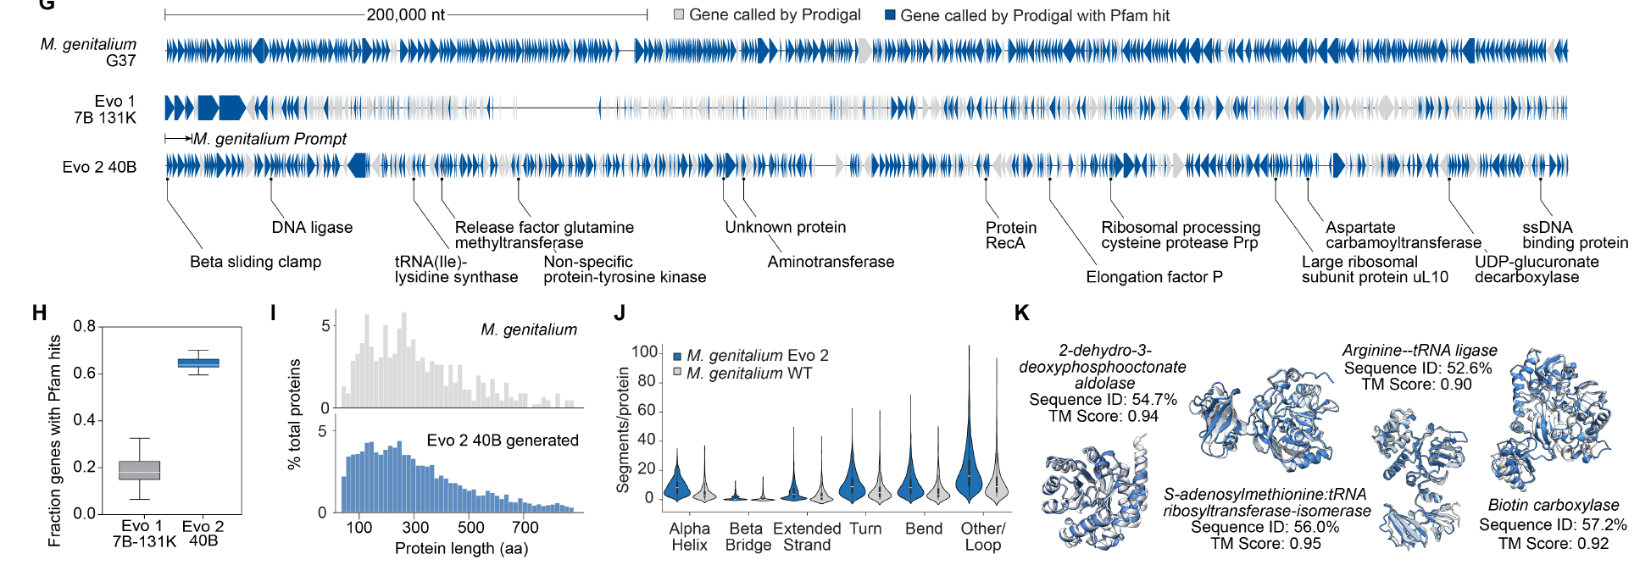
Genome generation: M. genitalium bacteria genome
Prompt: 10.5kb to generate 580 kb genome
Pfam hits: similar to natural protein sequence and structure
Similar protein lengths, number, and structure

Slide 28
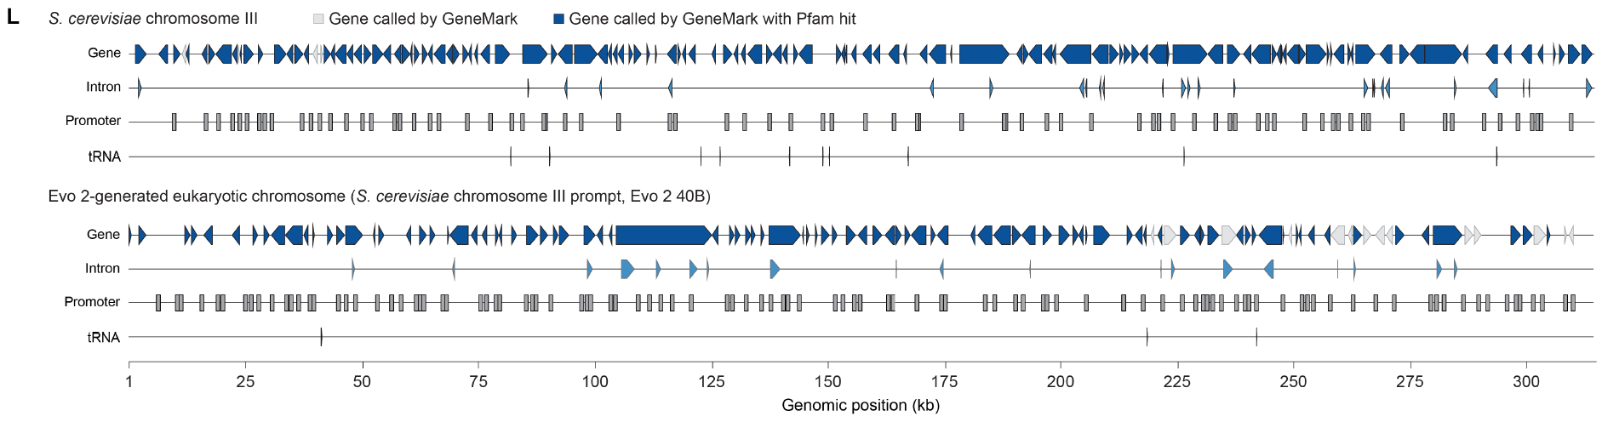
Genome generation: yeast chromosome
Prompt: 10.5kb to generate 330 kb chromosome
Including tRNAs, promoters, and genes with intronic structure
Generated proteins showed sequence and structural similarity to natural yeast genes

Slide 29
Generative epigenomics via inference-time search
Aim: Chromatin accessibility-guided approach to generate DNA sequence with desired pattern

Slide 30
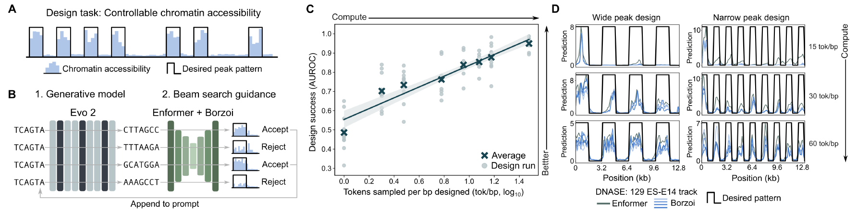
Chromatin accessibility-guided DNA generation
Using Enformer+Borzoi models to guide DNA generation
Generates128-bp DNA chunks, evaluated for chromatin accessibility
Beam search retains the top-scoring sequences at each step
More samples/(beam search width)/computation, better success
Designed multi-kb sequences with controlled accessibility at specified genomic positions

Slide 31
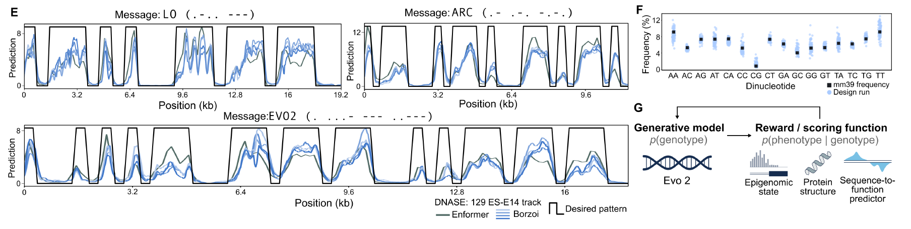
Chromatin accessibility-guided DNA generation
Just for fun: chromatin accessibility as Morse code
Favorable property:
Dinucleotide frequency match natural genome
Consensus of Enformer and Borzoi
Other sequence-based profiles to guide DNA generation
. - . . - - -
. - . - . - . - .

Slide 32
Summary
Evo 2 is the largest-scale fully open DNA LLM trained on largest genome data
Special architecture (StripedHyena 2) and training procedures
Applications:
DNA sequence annotation and interpretation
Genomic region prediction, mutation effects, gene essentiality
Meaningful model-derived features corresponding to diverse genomic features
DNA sequence generation
Unconstrained generation to natural-like sequences
Sequence-profile-guided generation to desirable sequences

Slide 33
Future directions
Improved prediction and variant analysis
improve pathogenicity prediction and structural variant analysis
Evolutionary and comparative genomics
modeling phylogenetic relationships and adaptive evolution
facilitate genome annotation and functional discovery
Advanced biological design
Extending Evo 2's epigenomic design approach to other biological properties, such as regulatory regions and synthetic gene circuits.
Multi-modal integration for Virtual Cell Modeling
Combining Evo 2's genomic representations with epigenomic, transcriptomic, and proteomic data for in silico simulation of complex cellular phenotypes in health and disease

